Slide 1
Measuring Undetectability in DNA Steganography:
A Dual-Channel System and Steganalysis Framework
PRESENTED BY
PROJECT GUIDE
Mr. S. Sai Bala Krishna
Assistant Professor,
Computer Science and Engineering
Nelluri Mahesh Kumar ( 24KN1A05EA)
Laveti Asritha (24KN1A05D1 )
Mugada Abhiram (24KN1A05D0)
Malleboina Venkata Mohan(24KN1A05D8 )

Slide 2
_{I} Abstract
This project integrates Artificial Intelligence, DNA cryptography, and QR code steganography to provide a secure data transmission system. AI improves encryption by selecting dynamic DNA encoding methods and secure keys, while machine learning detects QR code tampering. The framework ensures secure, efficient, and reliable communication across various real-world applications.

Slide 3
Problem Statement
Existing DNA steganography methods focus on hiding data but often fail to preserve natural DNA characteristics, making hidden information easier to detect. They also lack effective mechanisms to evaluate security against modern steganalysis. This project proposes a Dual-Channel DNA Steganography System with a Deep Learning-based Steganalysis Framework to improve security, reduce detectability, and ensure reliable hidden data transmission.

Slide 4
_{I} Title Justification
“Measuring Undetectability“
“DNA Steganography"
“Dual Channel & Steganalysis“
The system evaluates the exact probability of detection under modern statistical and deep-learning threat vectors. By implementing a standardized framework, we quantify the stealth quality of our stego-sequences rather than relying on basic visual evaluation.
The core carrier utilizes genomic sequences (synthetic or biological). Deoxyribonucleic Acid offers high resistance to physical degradation and offers extremely high sequence permutations, making it the ultimate medium for highly secure long-term secret storage
This justifies the system splits co-design framework.The data across dual biological pathways (e.g.coding/non-coding regions and utilizes deep neural networks (RNNs) as a steganalysis model to act as an automated security auditor.
.

Slide 5




I Key Project Objectives
Develop Dual-Channel Hiding Algorithms
Create separate optimization pathways for active genomic segments(coding exons) and inactive segments(non-codingintrons) to maximize embedding capacity.
Ninimize Codon and Character Variations
Apply a bio-inspired complementary substitution rule to prevent any shifts in nucleotide base frequency or codon distribution.
Construct a Deep Sequence Steganalysis Nodel
Build deep recurrent neural networks(RNNs) that analyze structural intron-exon models and identify potential payload signatures.
Nathematically Validate the Security Boundary
Evaluate key parameters including cracking probability, bits-per-nucleotide (BPN), and structural similarity indexes against modern steganalysis attacks.

Slide 6
Defined Project Scope
@ Biological Domain
«/» Technical Stock
Implementation of custom Python algorithms utilizing BioPython. Modeling and deployment of Deep Recurrent Neural Networks (LSTM/GRU) on specialized sequence datasets to extract features and classify natural versus tampered DNA chains.
@ Security & Analysis
The biological scope limits carriers to sequenced genomic datasets (such as standard reference human, plant, or bacterial GenBank sequences). It focuses on simulating real mutations, avoiding synthetic patterns that easily trigger detection.
Assurance of blind extraction capabilities (meaning the receiver extracts the secret data without needing the original host DNA) while guaranteeing high computational robustness against sequence alignment or mutation attacks.

Slide 7
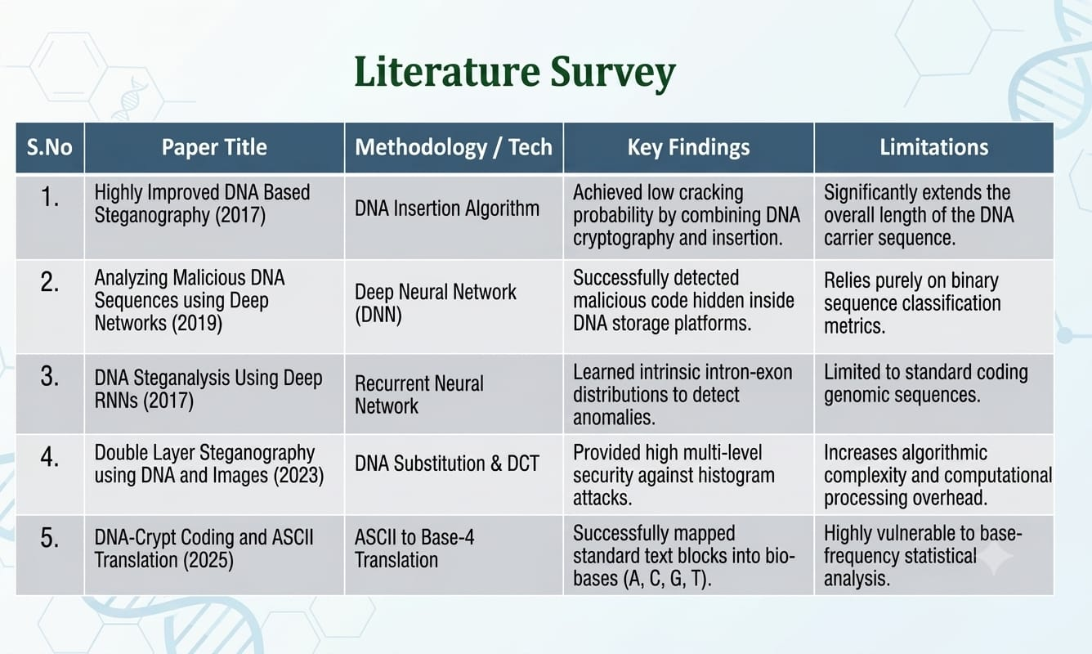

Slide 8
Existing System Drawbacks
Length Alterations
Inserting extra bases extends sequence length, allowing easy detection via sizing chromatography.
Base-Frequency Shirts
Most algorithms alter the natural balance of GC/AT ratios, making statistical detection simple.
Lack of Unified Steganalysis
Techniques are rarely tested against modern sequence-learning neural models.
Destruction of Biological Function
Tampering often ruins amino acid translation maps, rendering sequences biological failures.
Reference Sequence Dependency
Most systems require the original unmodified DNA sequence to extract the hidden
data.
Low Payload Capacity
Restricting hiding to non-functional zones minimizes overall payload efficiency.

Slide 9
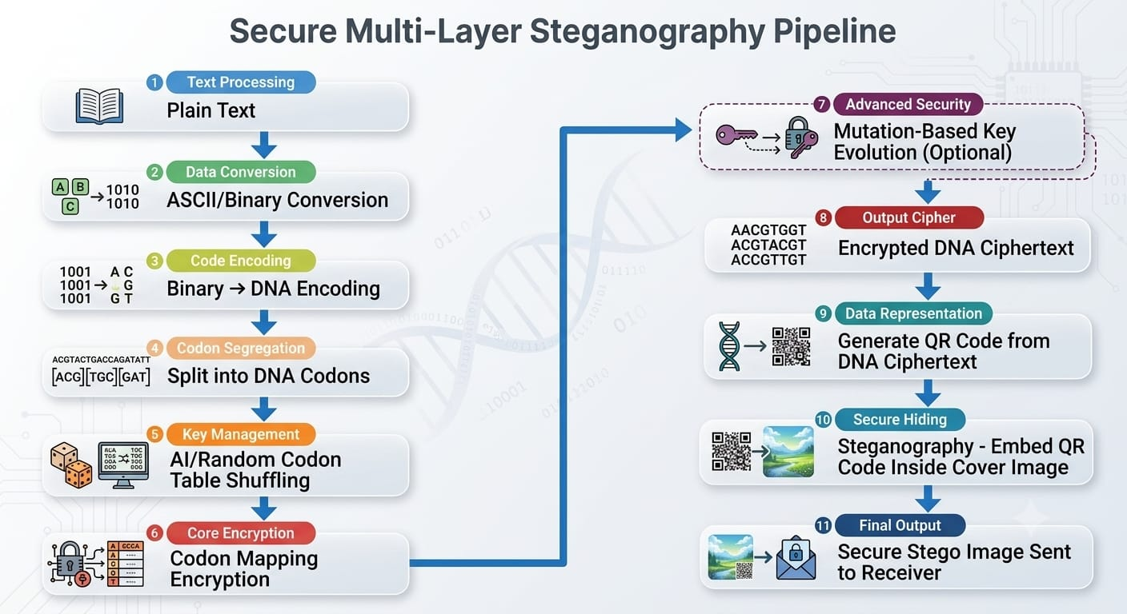

Slide 10
Technologies Uses
Python
QR-Code Generator Library
OpenCV
Num-py
Cryptography Library
DNA Encoding Algorithms
Steganography Techniques
Data Sets
NCBI Gen-Bank DNA Sequence
EMBI-EBI Nucleotide Data Base
Synthetic DNA Bench Mark Data Sets For Steganography Evaluation

Slide 11



Research Gap
Absence of Co-Designed Platforms
No unified framework offers both hiding(steganography) and testing(steganalysis) on a single workflow.
Neglecting biological DNA properties
Standard algorithms treat DNA as raw storage text, failing to respect amino acid mapping rules.
Inefhcient Dual-Pathways
Traditional systems use single-channelrouting, skipping the benefits of combining coding and non-codingfeatures.

Slide 12
Thank You
Measuring Undetectability in DNA Steganography: A Dual-Channel System and Steganalysis Framework

